Slide 1


Sales Symphony: Unlocking the Rhythms of City Scape Super Mart

Slide 2
AGENDA
Introduction
Problem
Process
Insights
Summary

Slide 3

INTRODUCTION
City Scape Super Mart is a successful online retail chain across various U.S. states.
Known for diverse product offerings and exceptional customer service.
Ensures broad accessibility for a diverse customer base.
One-stop-shop for customers
From everyday essentials to the latest trends.

Slide 4
Purpose:
Achieve sustained success for City Scape Super Mart
Specific Objectives:
Optimize operations.
Identify growth opportunities.
Provide actionable recommendations
Leverage insights from historical sales data.
Objective:
Enhance business strategies and improve overall performance.

Slide 5
PROCESS
Data Source
Data understanding
Data Cleaning
Data Analyzing
Gaining Insights

Slide 6
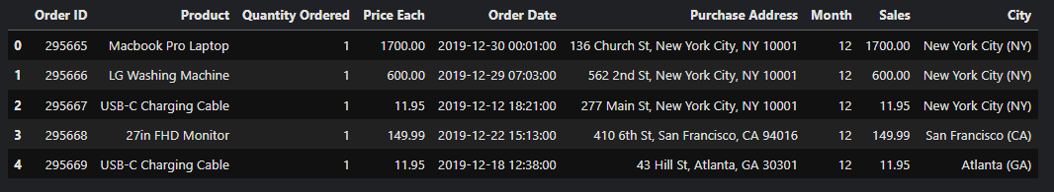
DATASET OVERVIEW
Kaggle Dataset
Tools used: Python
186850 rows and 6 columns
545 null values
Changing data types
Adding columns : Sales, State, City, Hour and Minute

Slide 7
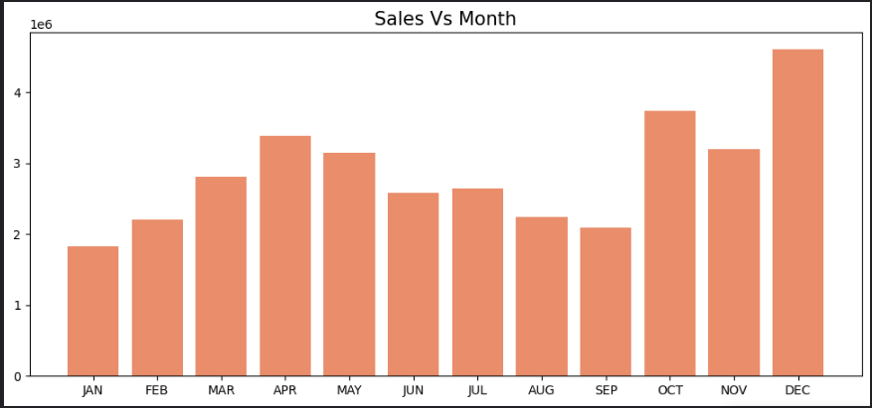
Sales Analysis
Sales Peaks in December
January Slump

Slide 8
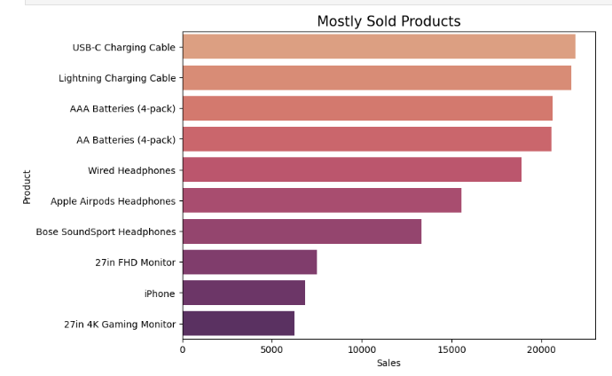
Product Performance
Identified the top 10 items with the highest sales figures.
"USB-C Charging Cable," "Lightning Charging Cable," and "AAA Batteries" emerged as the Key Performers

Slide 9
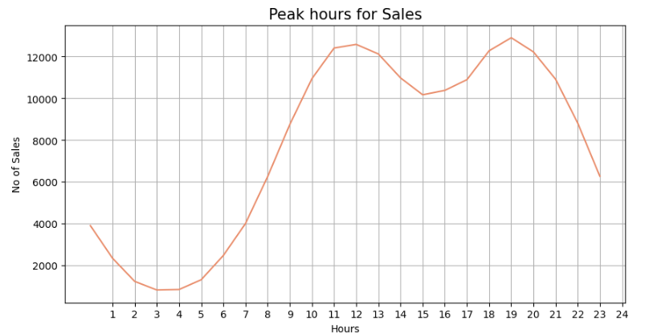
Peak hours of sales
Sales consistently peak after 10 am
Signifies a strong consumer presence during these hours

Slide 10
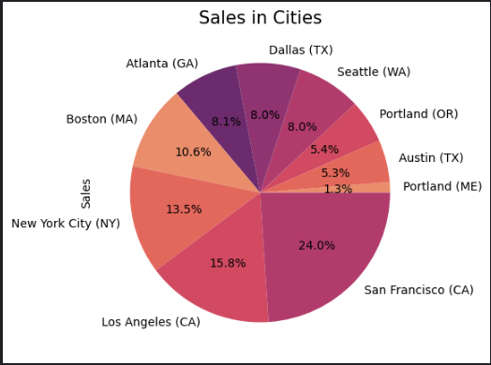
Regional Variations
San Francisco, Los Angeles, and New York stand are the key revenue generators

Slide 11
SUMMARY
Good overall performance
Effective market presence and strategic decision-making.

Slide 12
Insights
Developing a robust seasonal sales strategy
Offering special discounts on the highest sold products
Concentrate marketing efforts and customer engagement activities during the peak sales hours
Partnerships with local businesses
Optimize inventory management
monitor sales data and customer feedback
Keep an eye on competitors
diversify your product offerings
One level up
Keep an eye on competitors
diversify your product offerings

Slide 13


THANK YOU

